Slide 1
How to download required files for forensic labs

Slide 2
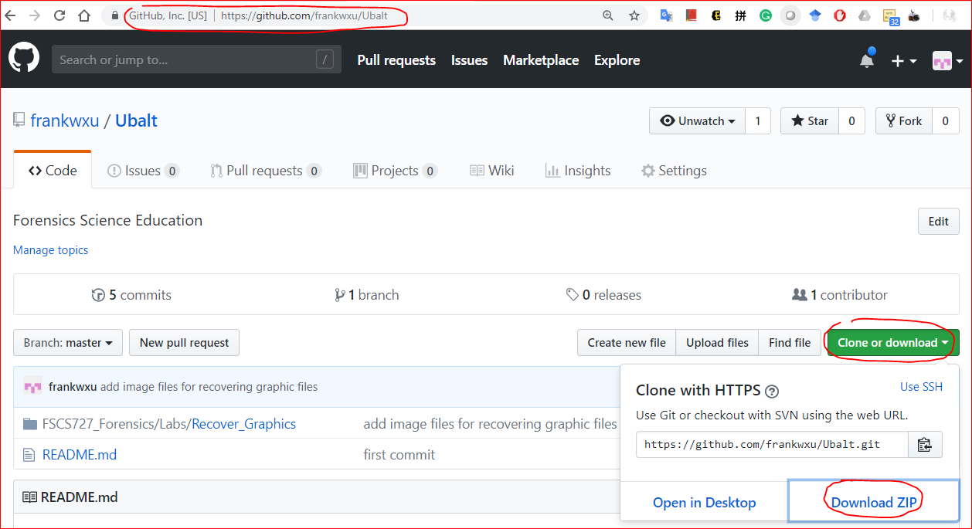
Download lab data

Slide 3
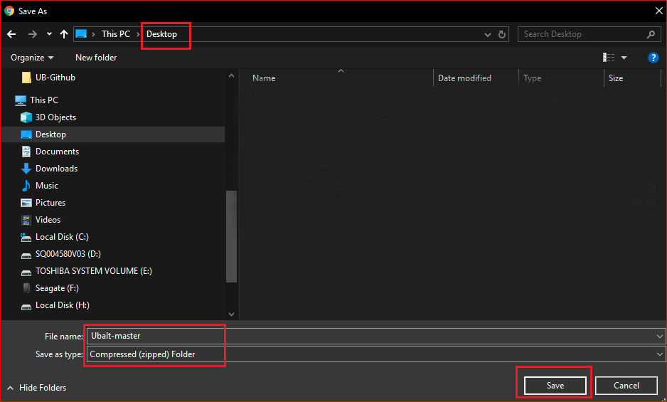

Slide 4
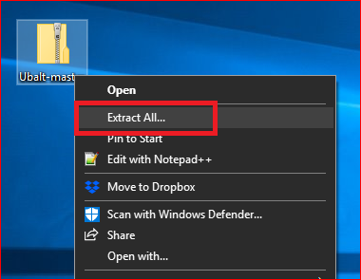
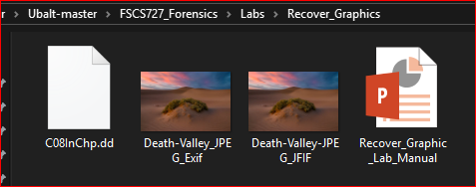

Slide 5
Understanding Graphics File Formats

Slide 6
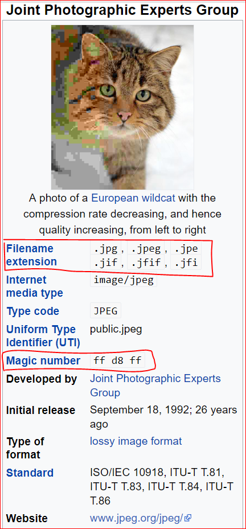
JPGE-Joint Photographic Experts Group
the name of the committee
is a commonly standard used method of lossy compression for digital photography.
only to a class of compression algorithms,
not to a specific file format.

Slide 7
The most common image file formats
JPEG/Exif (0xFFD8 FFE1): used by digital cameras and other photographic image capture devices.
JPEG/JFIF (0xFFD8 FFE0): : storing and transmitting photographic images on the World Wide Web.

Slide 8
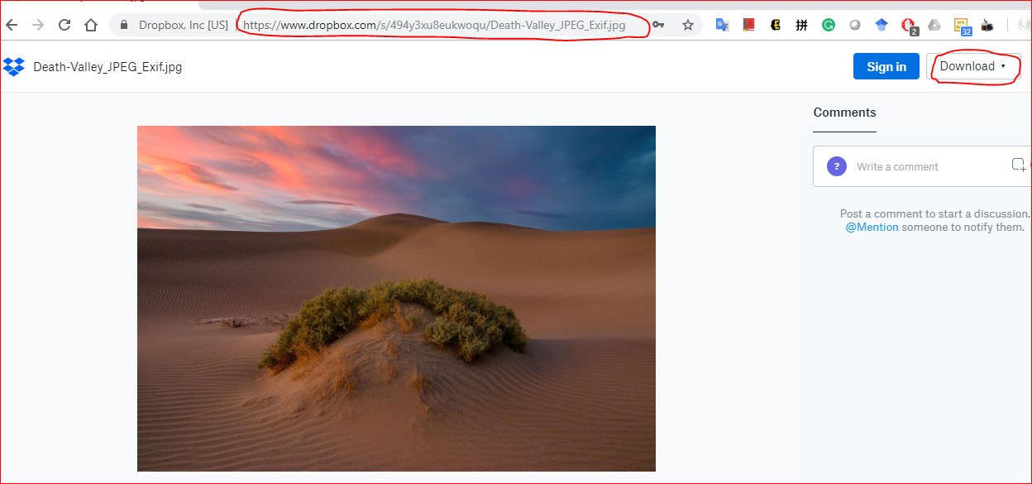
Check magic number
https://www.dropbox.com/s/494y3xu8eukwoqu/Death-Valley_JPEG_Exif.jpg
https://www.dropbox.com/s/qss9jzsa88gjvqs/Death-Valley-JPEG_JFIF.jpg
http://technologieshare.com/what-is-exif-data

Slide 9
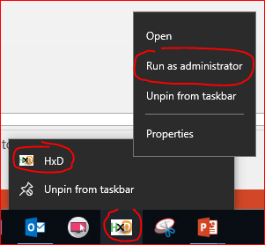
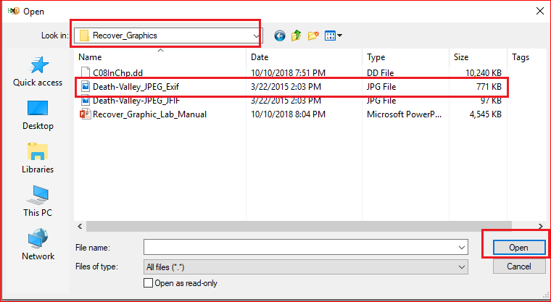
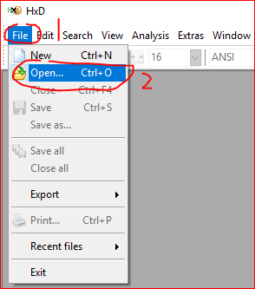

Slide 10
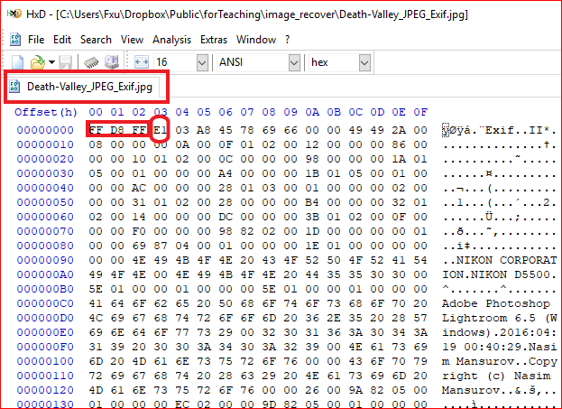
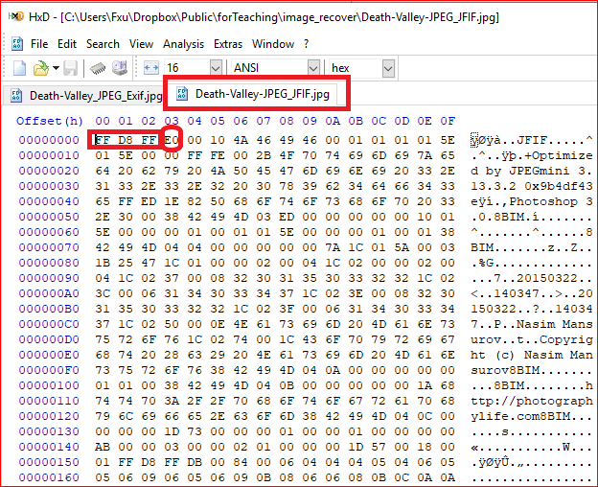

Slide 11
Repairing Damaged Headers

Slide 12
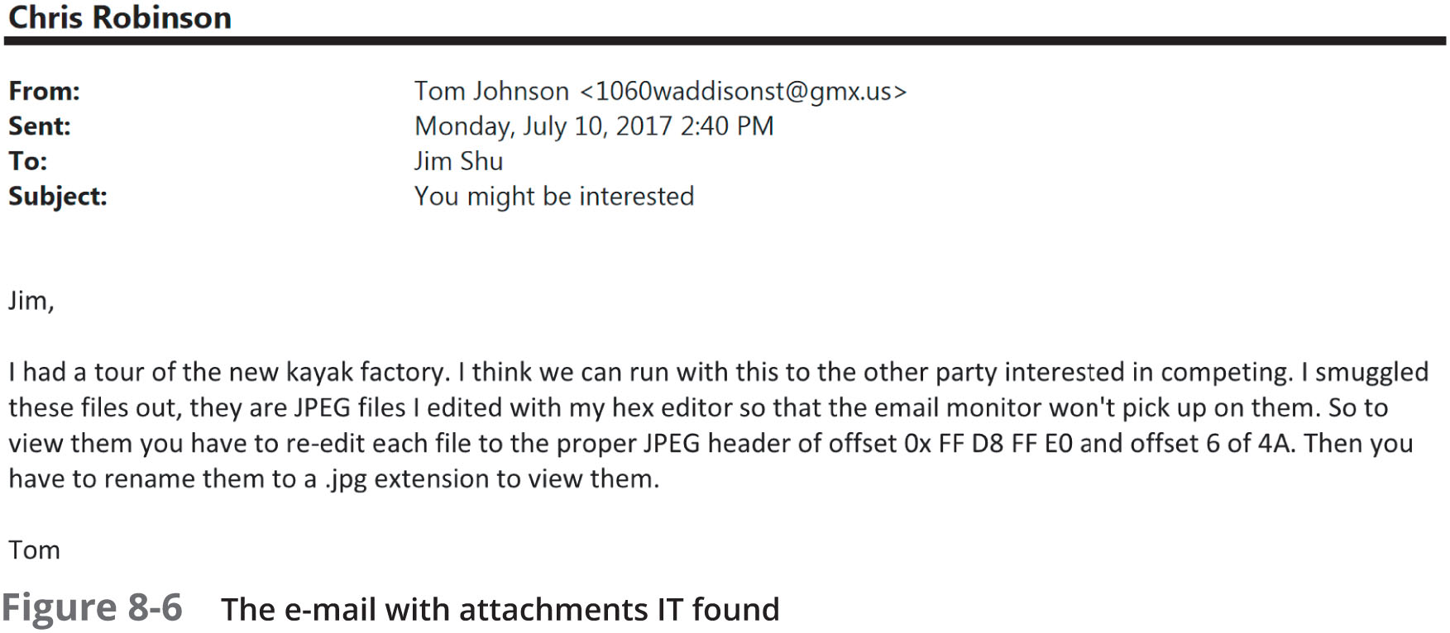
Case study
Investigate a possible intellectual property theft by a new employee of Superior Bicycles, Inc.

Slide 13
Understand the problem
“re-edit each file to the proper JPEG header of offset Ox FF D8 FF E0 and offset 6 of 4A”

Slide 14
Key Challenge
How to find these modified images?
We can research the string “FIF”

Slide 15
Key Challenge
How to find these modified images?
We can research the string “FIF”

Slide 16
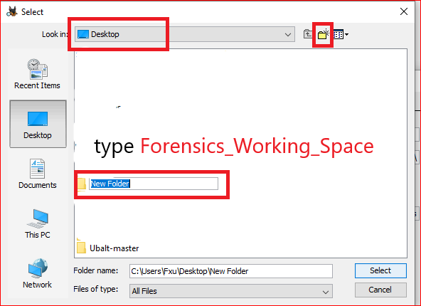
Create a working space

Slide 17
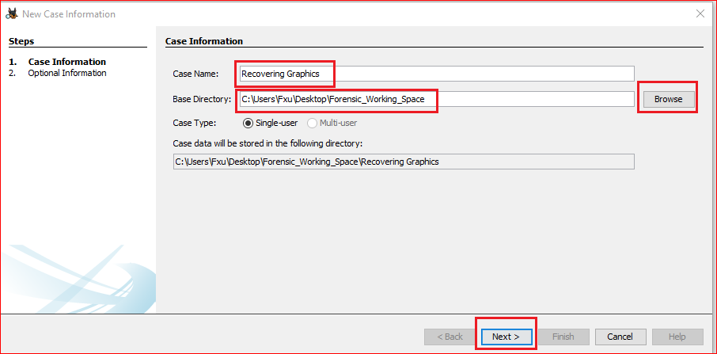
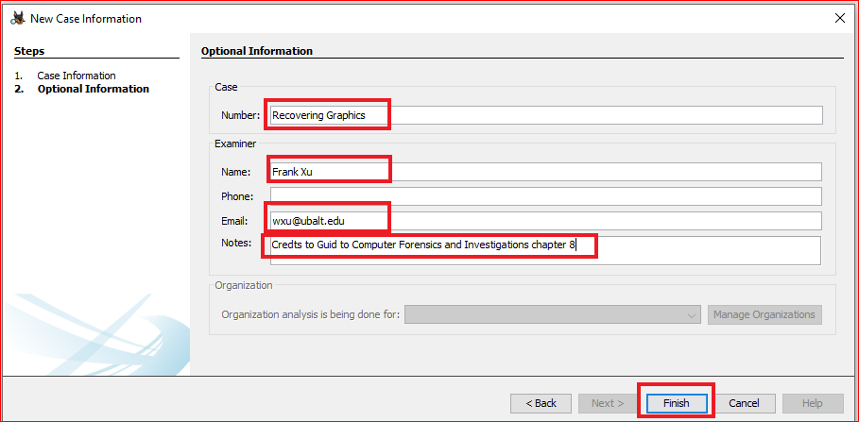

Slide 18
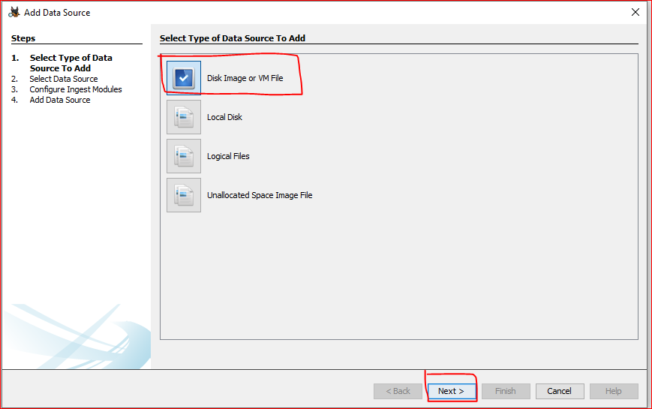
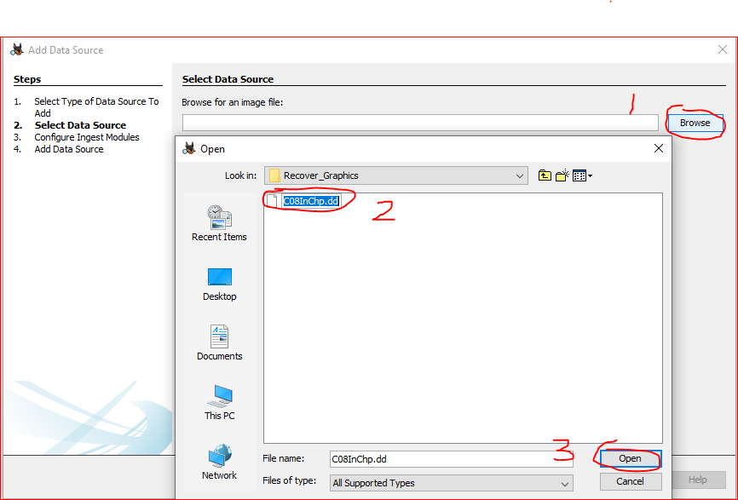

Slide 19
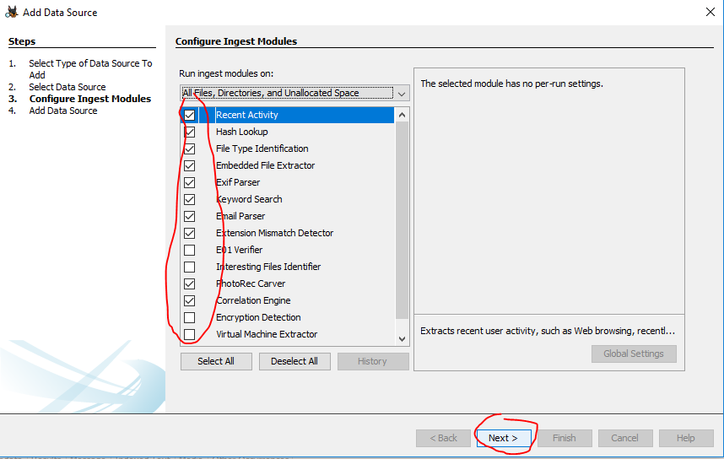

Slide 20
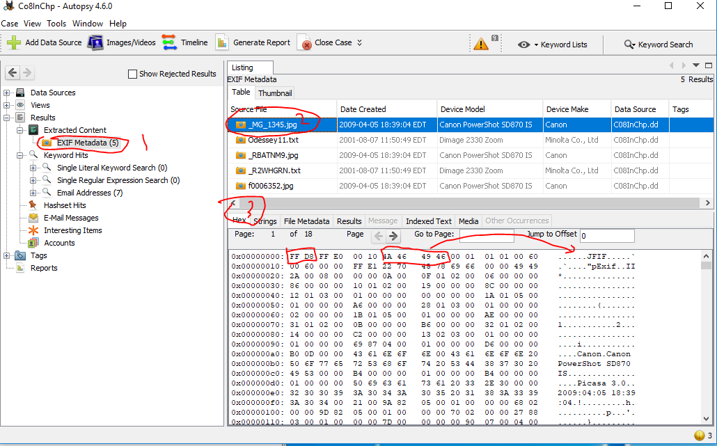

Slide 21
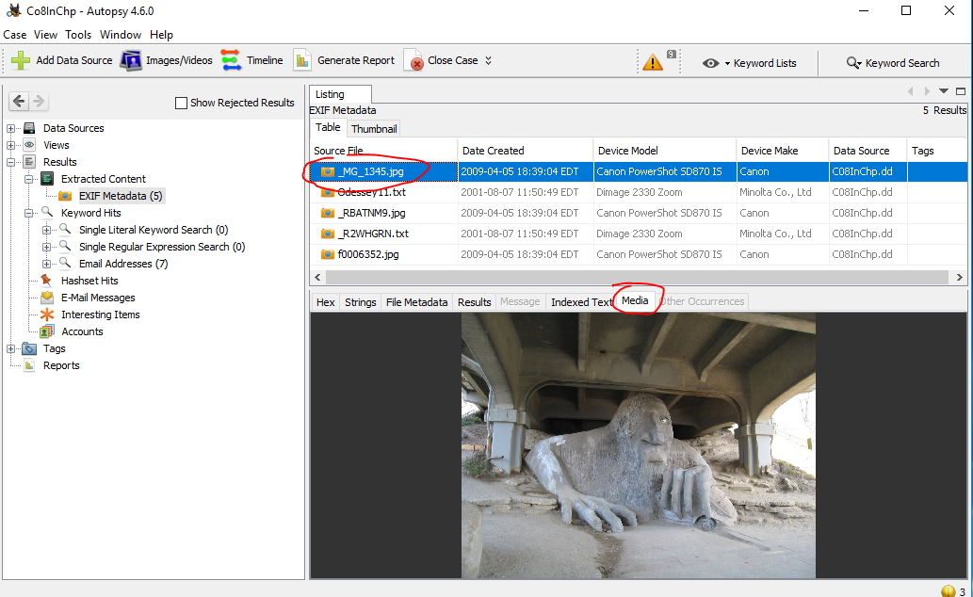

Slide 22
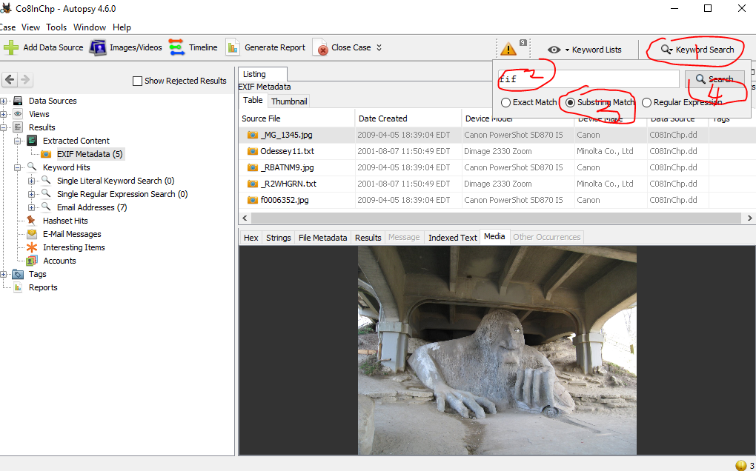
Search “FIF” substring

Slide 23
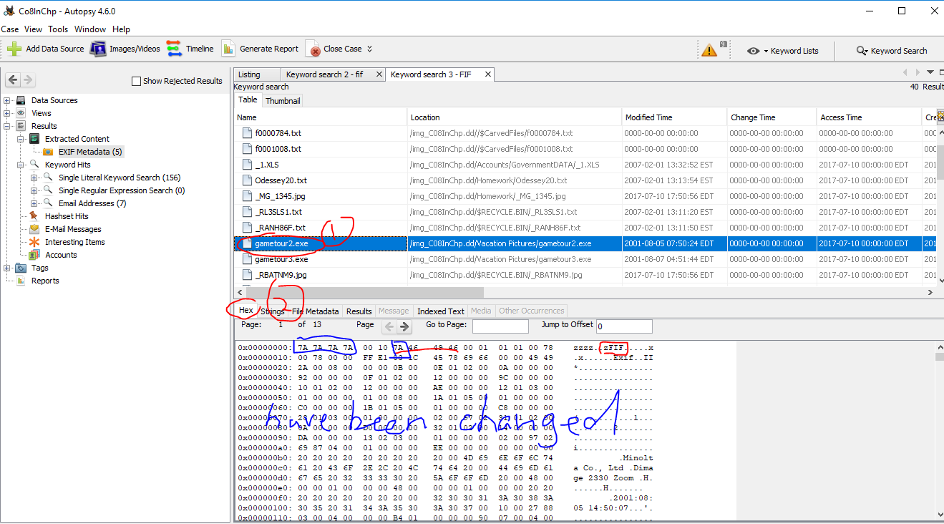

Slide 24
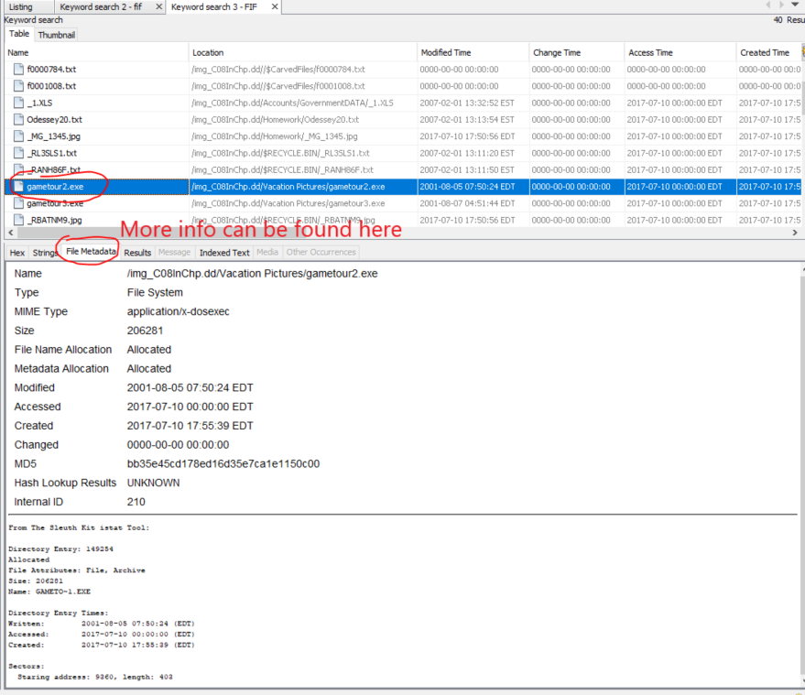

Slide 25
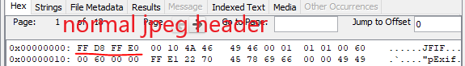
How to fix it?

Slide 26
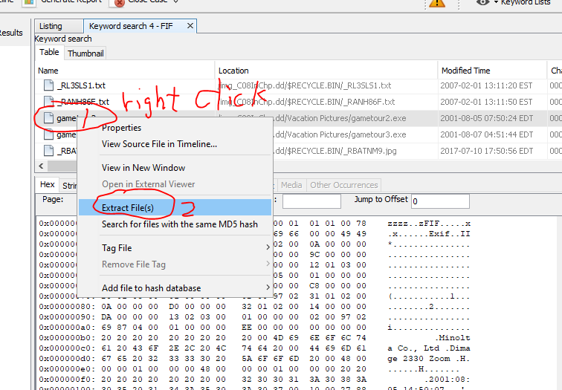
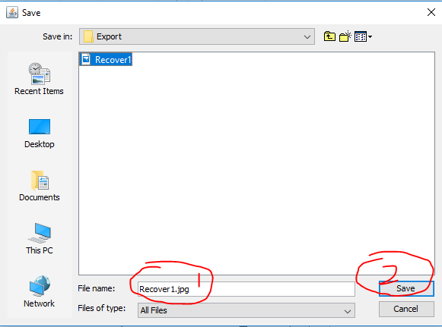
Extract the file

Slide 27
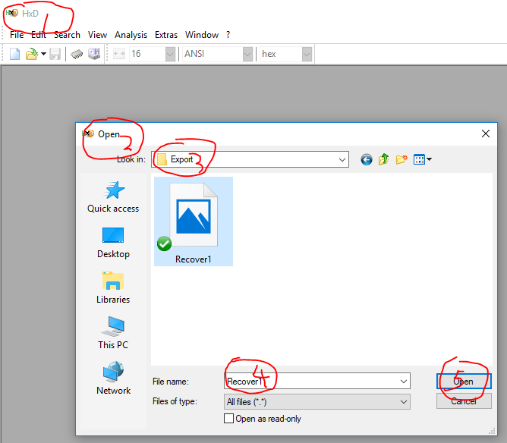
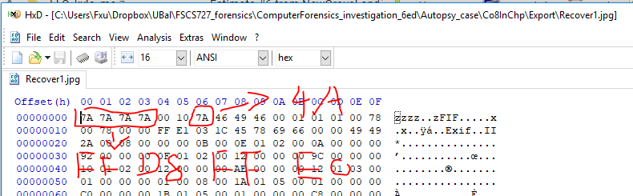
Rebuild File headers

Slide 28
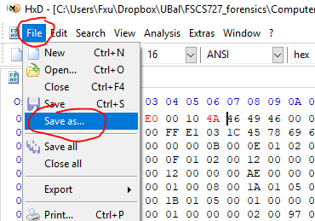
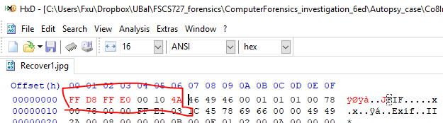
Rebuild File headers

Slide 29
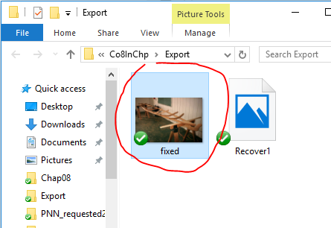
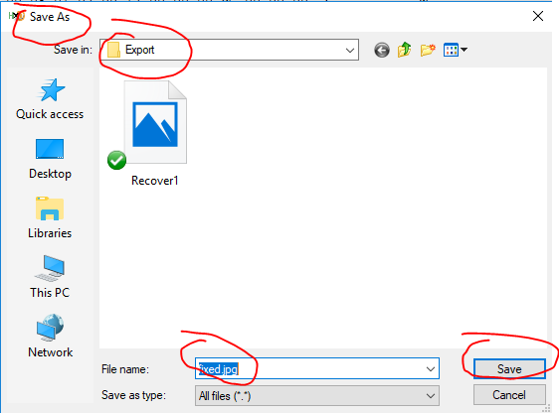
Rebuild File headers

Slide 30
Question?
Can you search and recover other pictures?

